Slide 1
PHT Plan Review Team 2023-2024 LNA/LPHP Reporting Update
Carrie Conia, KDPH/LHD TA Coordinator
August 6, 2024 (Virtual)

Slide 2
Local Needs Assessment Completed?
2023 No
5 Anticipated within 6 months
8 Anticipated within 12 months
2024 No
7 still need to complete LNA
5 of these are In Progress
September 2023 (100% response rate), July 2024 (62% response rate, additional updates supplemented by LHD/TA Coordinator)

Slide 3
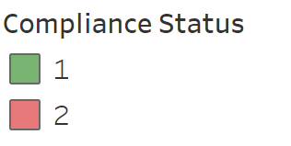
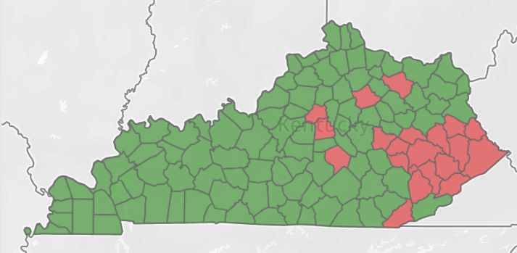
LNA Status 2023
Submitted LNA 2023
Did not Submit LNA 2023
Current as of September 2023

Slide 4
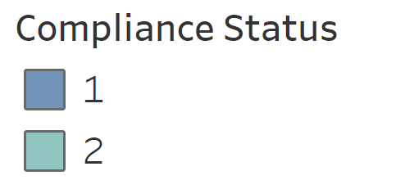
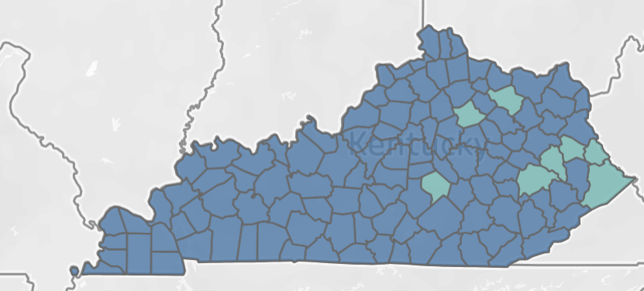
LNA Status 2024
Submitted LNA 2024
Did not Submit LNA 2024
Current as of July 2024

Slide 5
2023 LNA Priorities
2024 Data Coming Soon
Data as of September 2023

Slide 6
902 KAR 8.160 section 10 Local Needs Assessment
A local Needs Assessment that describes the prevailing health status and health needs of the population within the local health department’s jurisdiction shall be conducted at least once every five (5) years.
Year | 2023 | 2024
2017 | 1 | 1
2018 | 1 | 1
2019 | 8 | 5
2020 | 3 | 4
2021 | 4 | 4
2022 | 15 | 15
2023 | 16 | 19
2024 | - | 5
N/A | 13 | 7
Updates In Progress* | 2 | 3
*Revised Assessment to bring submission within 5 year time frame; does not include LHD that did not have a LNA to submit

Slide 7
902 KAR 8.160 Section 10 LNA Requirements
Statement of community health status
Description of the process
Involvement of Stakeholders
Community Demographics
Identified Health Inequities
Quantitative Data
Qualitative Data
 | 2023 | 2024
Submitted a LNA, CHA, or CHA/CHIP Report | 34 | 41
Submitted an online Dashboard | 6 | 7
Submitted LPHP Support Items | 6 | 7
Hospital Led | 9 | 10
Submitted items (work in progress) | 6 | 6

Slide 8
Thank you!

